Slide 1

IST 687 PROJECT: Customer Churn in the airline industry
GROUP 5
BHAVISH KUMAR
JOSEPH SABEL
LAXMAN KUMAR
SIHAN YANG
VIDUSHI MISHRA

Slide 2
INTRODUCTION
Problem Statement:
Dataset:
Reduce Southeast Airline’s customer churn by improving their Net Promoter Score (NPS)
10,282 customer surveys
capturing Likelihood to Recommend score of each customer along with other customer and flight attributes
14 partner airlines

Slide 3
BUSINESS QUESTIONS
How does the Likelihood to Recommend Score spread across different Traveler Class, Gender, Travel Type, Airline Status, Age Groups & Partner Airlines?
What is the median Recommendation score for each Traveler Class, Gender, Travel Type, Airline Status, Age Groups & Partner Airlines?
Does Flight Cancellation affect NPS score? i.e. Do cancelled flights have more Detractors than Promoters?
How many survey observations do we have for each Partner Airline, Traveler Class, Travel Type, Airline Status and Age Groups across the 2 Genders?
Based on NPS, which are the top performing partner airlines, and which are the poor performing partner airlines?

Slide 4
Data cleaning
Treated a few NAs of non cancelled flights with mean of columns at route partner level
Treated NAs in flight duration column with 0 for cancelled flights
Renamed columns to get rid of ‘dot’ in column header

Slide 5
EXPLORATORY DATA ANALYSIS

Slide 6
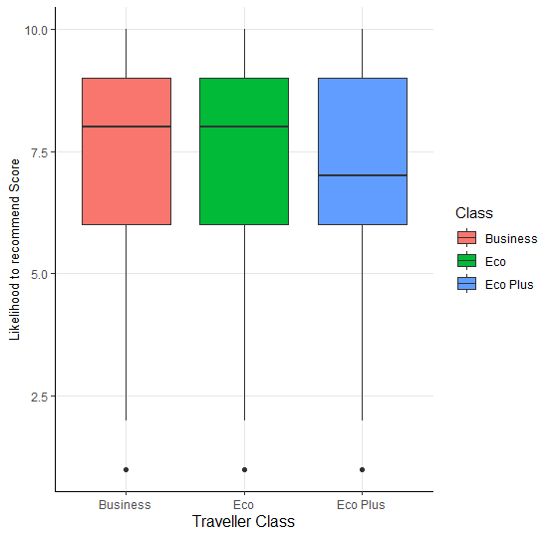
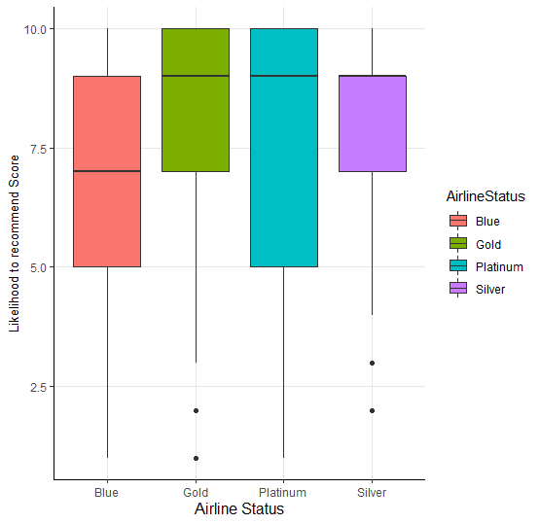
Box plot of Likelihood to Recommend score across Traveler Type & Airline Status
Low median value for Eco Plus customers
Business Travelers have highest number of promoters
Low median value for Blue Airline Status
Silver has high median with low spread
Notes:
Low median value for Personal Travelers
Business Travelers have highest number of promoters
->

Slide 7
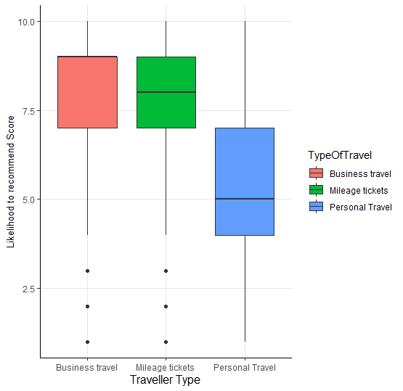
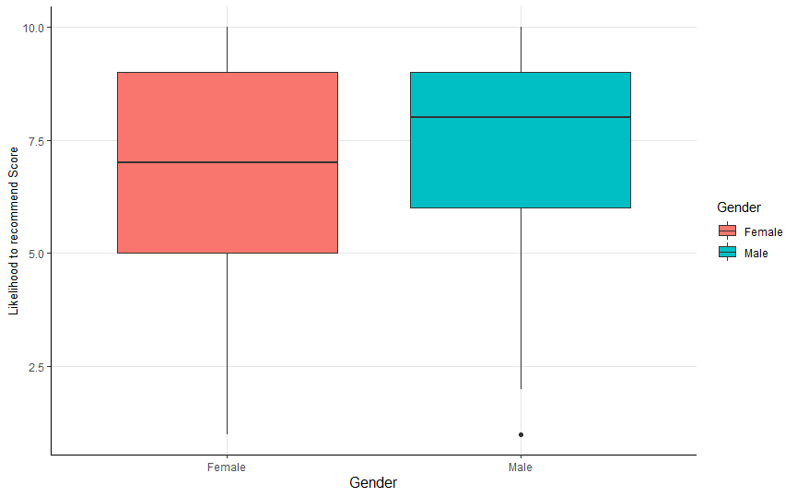
Box plot of Likelihood to Recommend score across Traveler Type & Airline Status
Low median value for Personal Travelers
Business Travelers have highest number of promoters
Low median value for Female customers

Slide 8
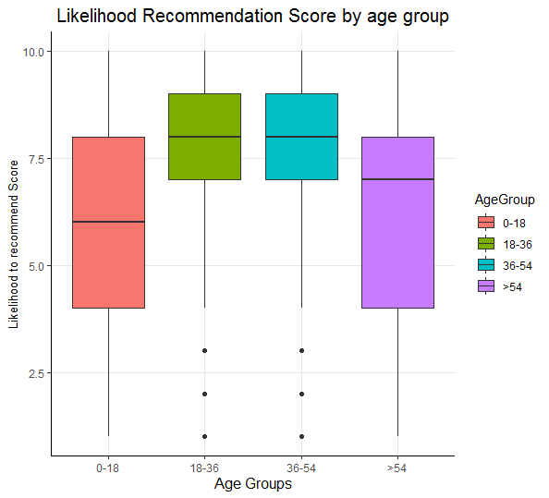
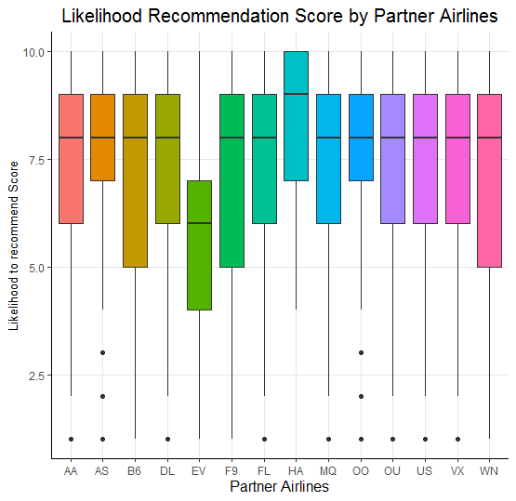
Box plot of Likelihood to Recommend score across Age Groups
AA : Paul Smith Airlines Inc.
AS : FlyToSun Airlines Inc.
B6 : OnlyJets Airlines Inc.
DL : Sigma Airlines Inc.
EV : FlyFast Airways Inc.
F9 : GoingNorth Airlines Inc.
FL : FlyHere Airways
HA : West Airways Inc.
MQ : EnjoyFlying Air Services
OO : Northwest Business Airlines Inc.
OU : Oursin Airlines Inc.
US : Southeast Airlines Co.
VX : Cool&Young Airlines Inc.
WN : Cheapseats Airlines Inc.
Lowest median value for 0-18 age group
Lowest median value for FlyFast Airways & close to 75% of FlyFast customers are detractors
Notes:
X`

Slide 9
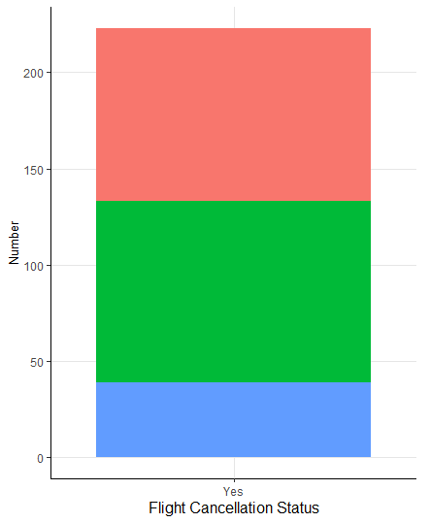
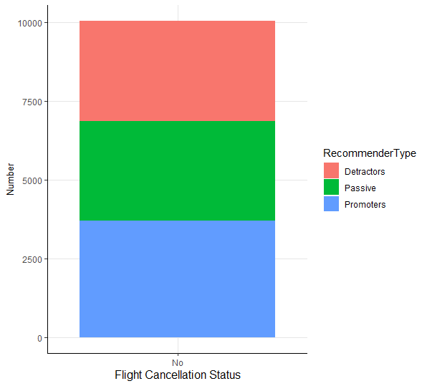
Overall NPS of southeast airlines based on flight cancelation status
Cancelled flights have almost three times more detractors than promoters

Slide 10
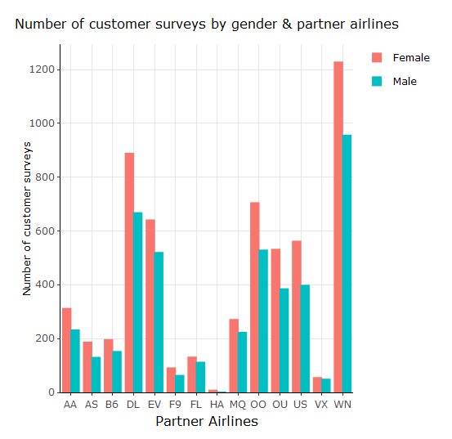
Number of customer survey Observations
AA : Paul Smith Airlines Inc.
AS : FlyToSun Airlines Inc.
B6 : OnlyJets Airlines Inc.
DL : Sigma Airlines Inc.
EV : FlyFast Airways Inc.
F9 : GoingNorth Airlines Inc.
FL : FlyHere Airways
HA : West Airways Inc.
MQ : EnjoyFlying Air Services
OO : Northwest Business Airlines Inc.
OU : Oursin Airlines Inc.
US : Southeast Airlines Co.
VX : Cool&Young Airlines Inc.
WN : Cheapseats Airlines Inc.
West Airways and Cool&Young Airlines have a very smaller number of survey observations

Slide 11
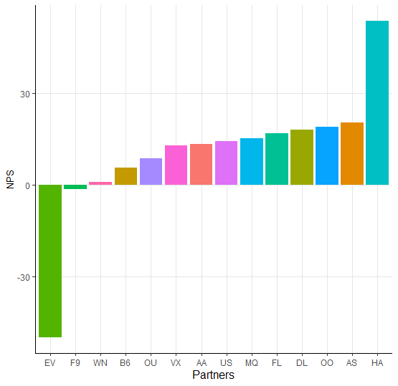
NPS of each partner airline
AA : Paul Smith Airlines Inc.
AS : FlyToSun Airlines Inc.
B6 : OnlyJets Airlines Inc.
DL : Sigma Airlines Inc.
EV : FlyFast Airways Inc.
F9 : GoingNorth Airlines Inc.
FL : FlyHere Airways
HA : West Airways Inc.
MQ : EnjoyFlying Air Services
OO : Northwest Business Airlines Inc.
OU : Oursin Airlines Inc.
US : Southeast Airlines Co.
VX : Cool&Young Airlines Inc.
WN : Cheapseats Airlines Inc.
West Airways, FlyToSun, Northwest & Sigma airlines are ranked top 4 in terms of performance based on NPS
FlyFast Airways, & GoingNorth Airlines are the worst performing partners with negative NPS (More Detractors than Promoters)

Slide 12
How can we help Southeast Airlines
Identify Rules, i.e. set of customer & flight attribute values that are most likely to make a customer a Promoter, using Association Rules Mining
Similarly, identify set of customer & flight attribute values that are most likely to make a customer a Detractor
Help decide which partners to keep & drop by predicting NPS of each partner airline for future flights by:
Predicting the Likelihood to Recommend score of customers for future flights using a linear model
For every customer predict whether he/she is going to be a Promoter, a Detractor or Passive using a classification model

Slide 13
MODEL PREPARATION

Slide 14
Linear model – PREDICT LIKELIHOOD TO RECOMMEND SCORE
The following attributes were identified to be essential for making the best prediction :
Airline Status, Age, Gender, Price Sensitivity, Loyalty, Type of Travel, Food Expenses, Flights per Year, Shopping Amount, Class, Schedule Departure Hour, Total Delay, Partner Code, Flight Duration, Distance, Origin State and Destination State
Created 2 models for Non-Cancelled and Cancelled flights by excluding the 4 partners with highest NPS (West Airways, FlyToSun Airlines, Northwest Business Airlines & Sigma Airlines)
For Non-Cancelled Flights
49.3% of variation in recommendation score can be explained by variation in predictor attributes (Adj R square)
22% accuracy in the predicted likelihood to recommend score
54% accuracy in the predicted score’s corresponding recommender type bucket
For Cancelled Flights
39% Adj R square
35% accuracy in the predicted likelihood to recommend score
73% accuracy in the predicted score’s corresponding recommender type bucket

Slide 15
Association Rules Mining
We use the following attributes to detect whether the customer recommends this airline or not :
Airline Status, Age Groups, Gender, Type of Travel, Class and Recommender Type
Put Recommender Type on the right-hand side and identify the set of customer attributes that make a customer a Promoter & Detractor

Slide 16
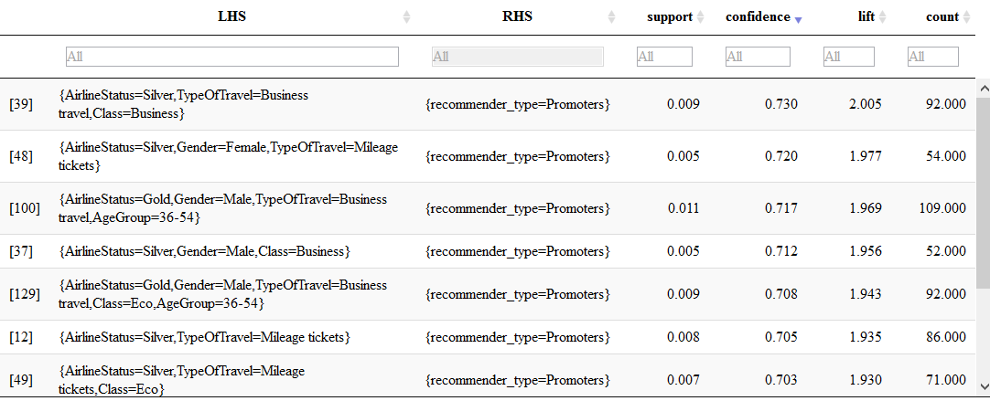
Association Rules Mining (Promoters)
Customers with Airline Status Silver & on Business Travel, traveling by Business Class are highly likely to become Promoters.

Slide 17
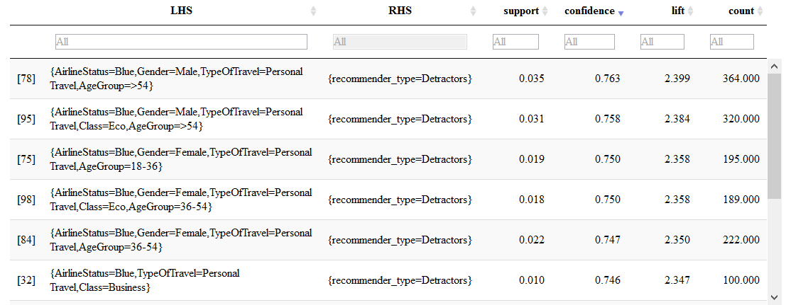
Association Rules Mining (Detractors)
Male customers over 54 years with Airline Status Blue & on Personal Travel are highly likely to become Detractors.

Slide 18
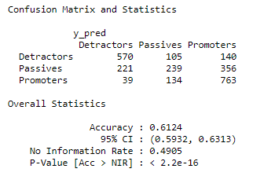
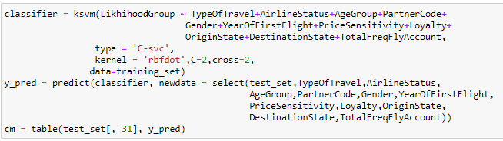
Support Vector Machine

Slide 19
SUMMARY

Slide 20
Recommendations
Economy Plus travel class customers need to be targeted specially so as to reduce the churn, because 50% of the economy plus customers are either Passive or Detractors
Female customers churn is high because 50% of the female customers are either passive or detractors, less than 25% are promoters and hence they require special attention
Large number of Business Travelers are Promoters and around 75% of Personal Travelers are Detractors, because of which Personal Travelers & Business Travelers need to be treated alike to increase NPS for Personal travelers
Southeast should focus on improving the experience of Customers with Blue Airline status to improve NPS
Flight cancellations result in decrease in NPS and southeast should focus on reducing flight cancellations, as 41% of customers who experienced flight cancellations are detractors and only 18% are promoters
FlyFast Airways & GoingNorth Airlines are the worst performing partners with negative NPS. Hence Southeast should focus on improving the experience of customers with these 2 partners
Around 50% of the customers < 18 years old & >54 years old are detractors and hence customers of these age groups require special attention.

Slide 21

THANK YOU!!

Slide 22
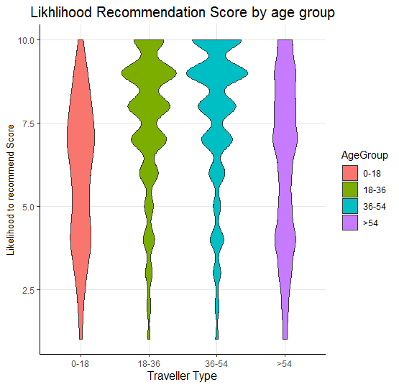
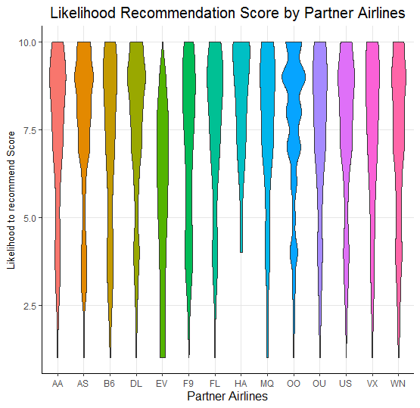
APPENDIX

Slide 23
Linear model for top 4 partners
Created 2 Linear models for Non-Cancelled and Cancelled flights for the top 4 partners with highest NPS (West Airways, FlyToSun Airlines, Northwest Business Airlines & Sigma Airlines)
For Non-Cancelled Flights
39.4% of variation in recommendation score can be explained by variation in predictor attributes (Adj R square)
For Cancelled Flights
86.4% Adj R square

